Slide 1



Call Centre
View in Power BI
Last data refresh:
12/6/2023 6:33:19 PM UTC
Downloaded at:
12/6/2023 6:36:25 PM UTC

Slide 2
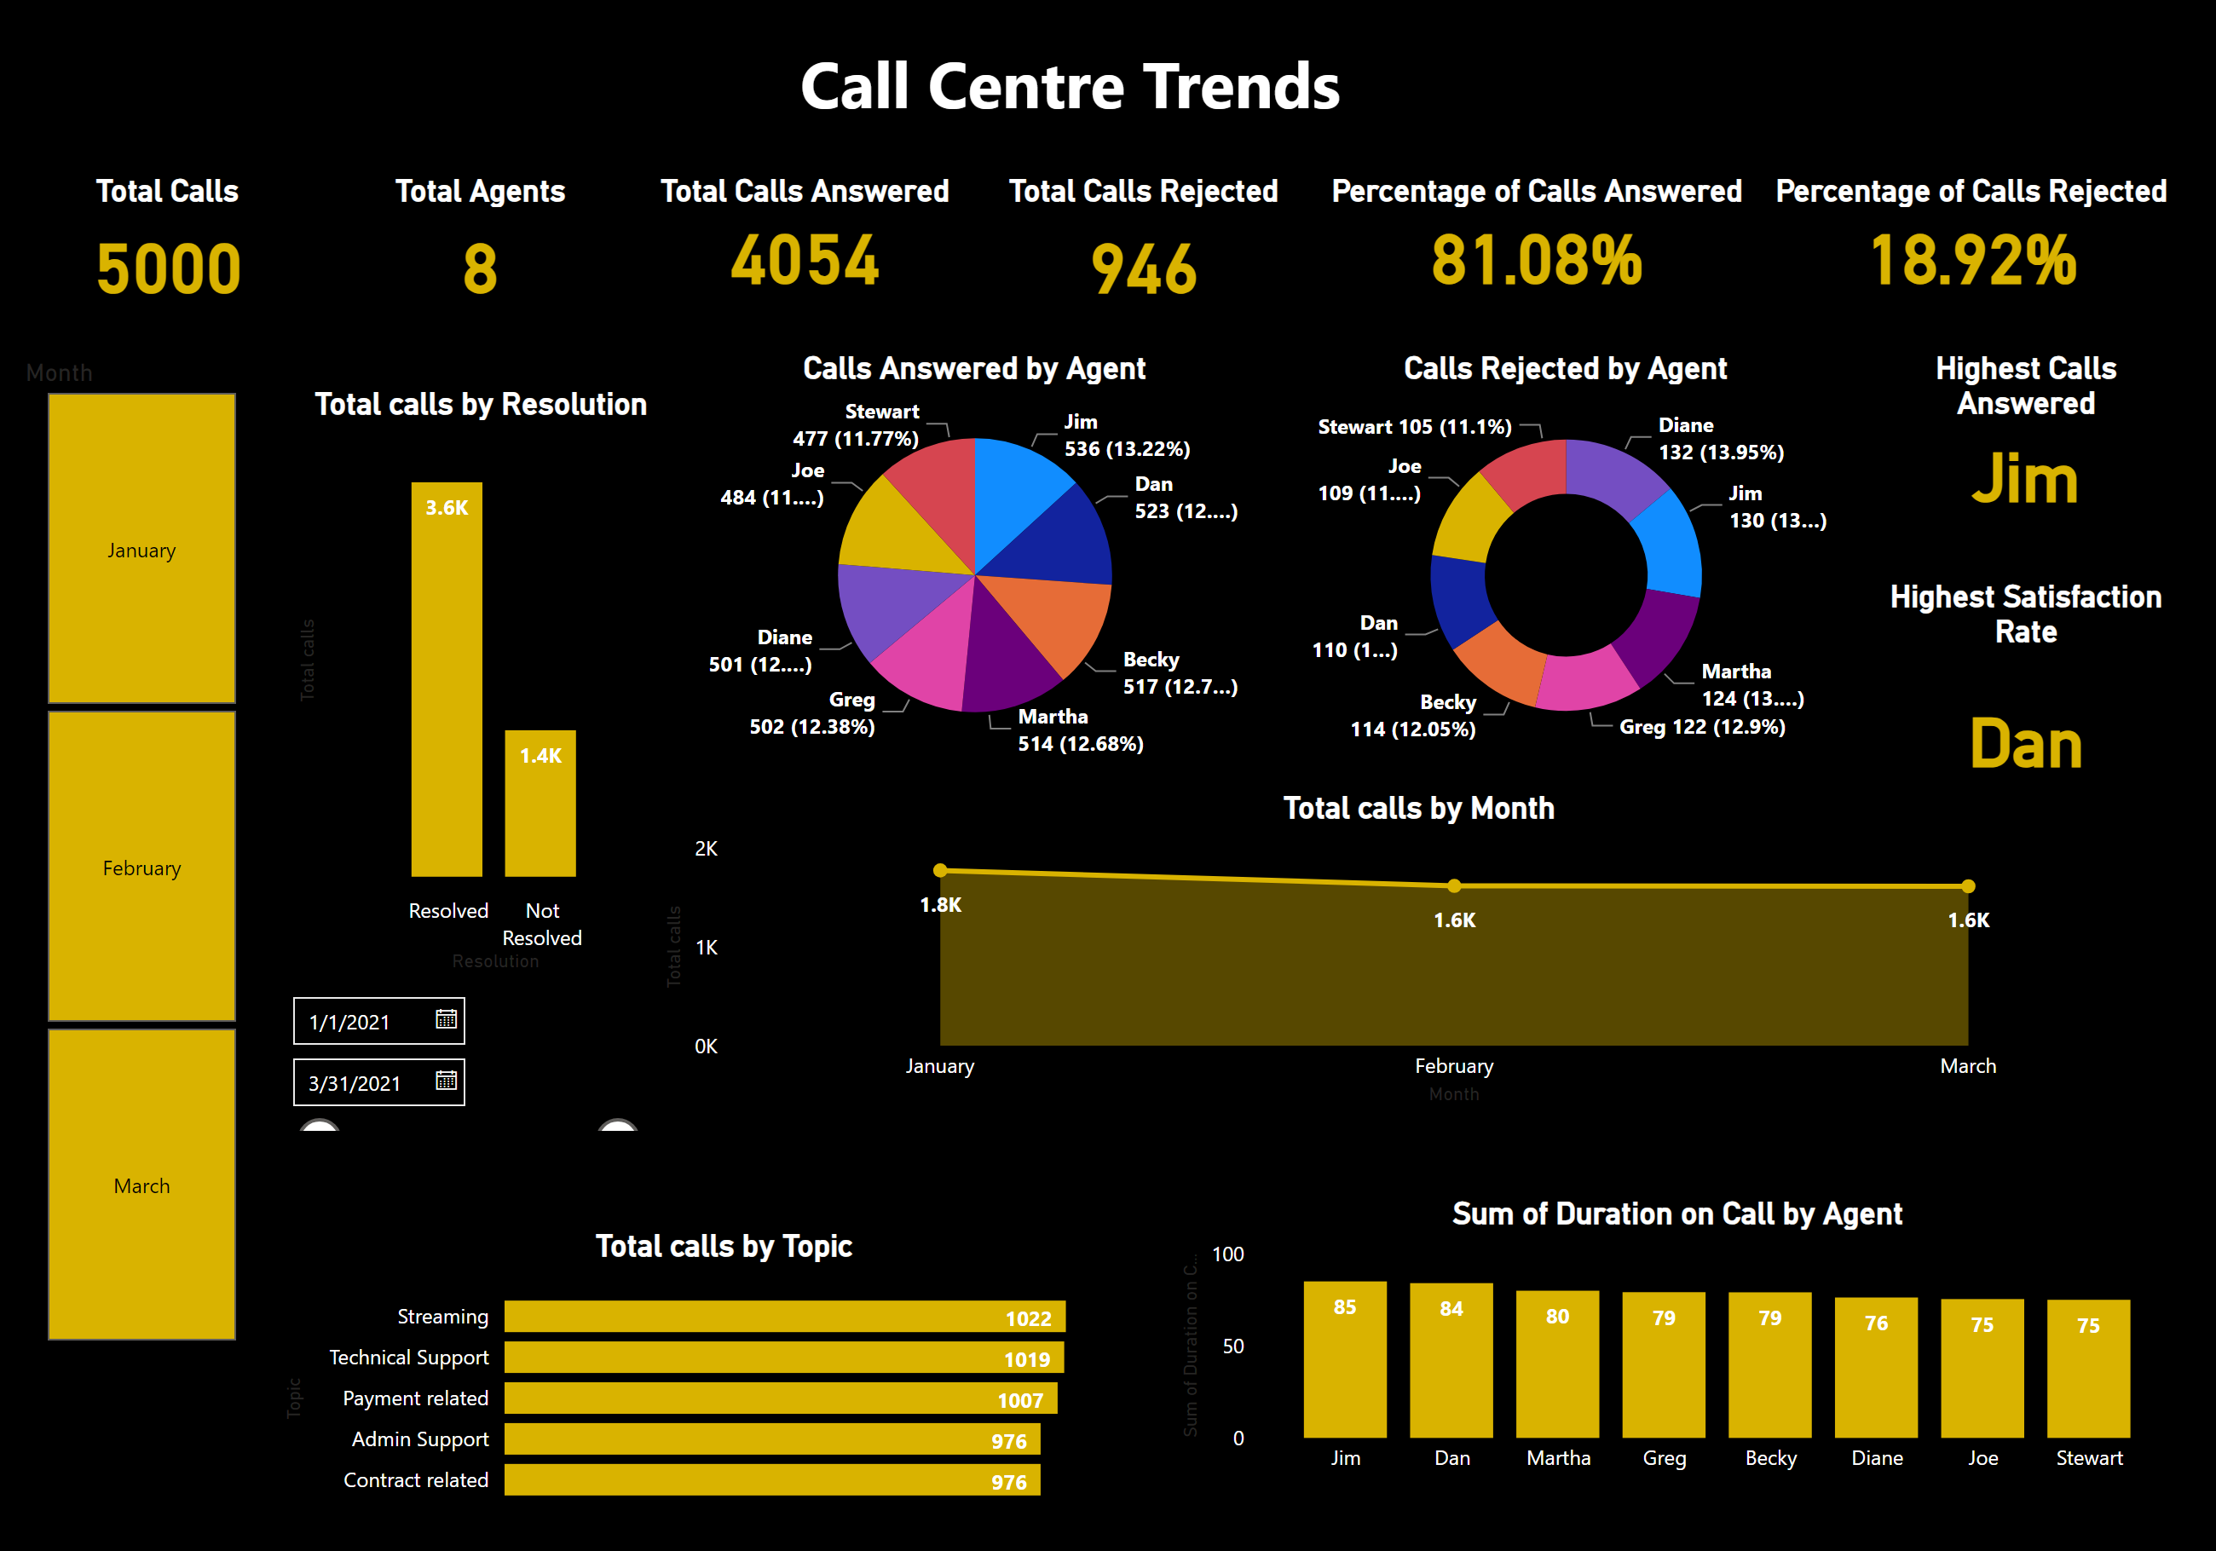
Page 1
Notes:
Total Calls
No alt text provided
Total Agents
No alt text provided
Total Calls Answered
No alt text provided
Total Calls Rejected
No alt text provided
Percentage of Calls Answered
No alt text provided
Percentage of Calls Rejected
No alt text provided
columnChart
No alt text provided
Highest Calls Answered
No alt text provided
Highest Satisfaction Rate
No alt text provided
barChart
No alt text provided
columnChart
No alt text provided
areaChart
No alt text provided
slicer
No alt text provided
slicer
No alt text provided
Calls Answered by Agent
No alt text provided
Calls Rejected by Agent
No alt text provided
textbox
No alt text provided

